Slide 1
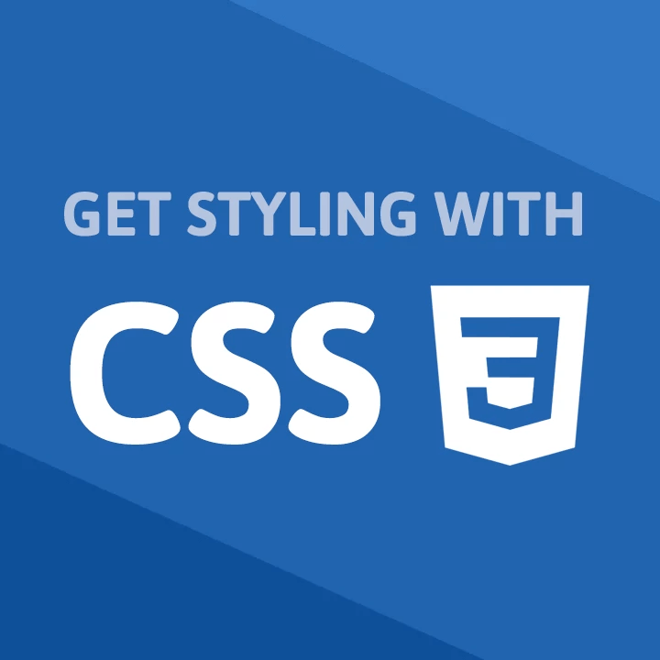
CSS
-By Aabha bhandari

Slide 2
Topics
What is CSS
Features of CSS
Why is CSS needed
Starting with CSS
Syntax of CSS
Selectors in CSS

Slide 3


What is CSS
CSS (Cascading Style Sheets) is what makes web pages look good and presentable.
CSS describes how HTML elements are to be displayed on screen
It’s an essential part of modern web development and a must have skill for any web designer and developer.
It is very easy to learn and code in compare to other language even beginners can easily learn CSS.

Slide 4

Features of CSS
There are many Features of CSS the major features are:
Easy to Learn : CSS is easy to learn and understand also it provides powerful control over the presentation of an Web Page.
CSS saves time : We can write CSS once and then reuse same sheet in multiple HTML pages.
Multiple Device Compatibility : Style sheets allow content to be optimized for more than one type of device.
Pages load faster : If you are using CSS, you do not need to write HTML tag attributes every time. Just write one CSS rule of a tag and apply it to all the occurrences of that tag therefore less code means faster download times.
Easy maintenance : To make a global change, simply change the style, and all elements in all the web pages will be updated automatically.

Slide 5


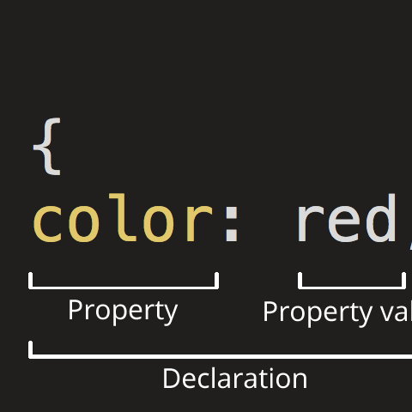
Why CSS is needed
CSS is important because it allows web designers, developer to make websites unique and attractive.
Earlier any modification in the design of website was a very difficult and boring task as it involves manually editing every HTML Page
In the past, setting up HTML files so that they were accessible to screen-readers and other kinds of methods was a pain. CSS3 has made this easier.
Earlier support of multiple browser was difficult task.
It makes page look attractive so that reader can hook to the page.

Slide 6
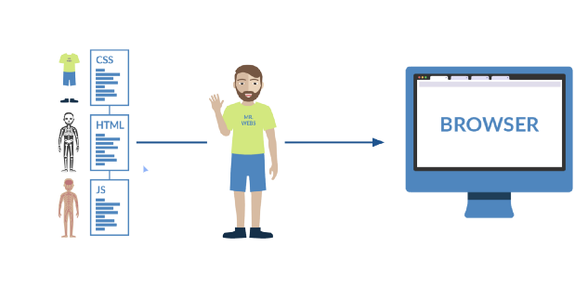
CSS is like outfit of a web-page which makes is to look attractive.

Slide 7

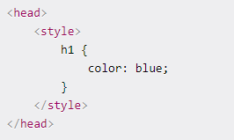

Starting with CSS
First of all we will learn how to include CSS in our webpage or projects. There are three ways we do that.
Inline CSS: We can include CSS directly in our HTML elements. For this, we make use of the style attribute and then we provide properties to it.
Internal CSS: The other way to include CSS is using the style element in the head section of the HTML document. This is called internal styling.
3. External CSS: The third and most recommended way to include CSS is using an external stylesheet. We create a stylesheet with a .css extension and include its link in the HTML document

Slide 8
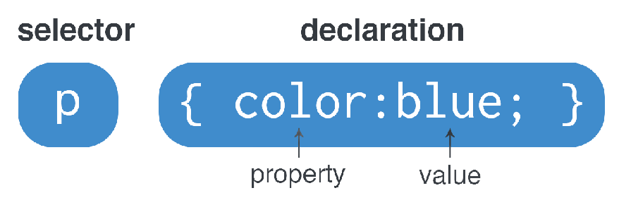
Syntax of CSS
CSS is having very easy and minimal syntax
In CSS Rule for Syntax is selector { property: value }
Selector : A selector is an HTML tag at which a style will be applied. This could be any tag like <h1> or <table> etc.
Property : A property is a type of attribute of HTML tag. Put simply, all the HTML attributes are converted into CSS properties. They could be color, border etc.
Value : Values are assigned to properties. For example, color property can have value either red or #F1F1F1 etc.

Slide 9
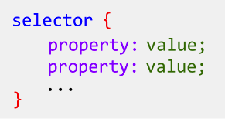
Selectors in CSS
CSS selectors are used to select the content you want to style
CSS selectors select HTML elements according to its id, class, type, attribute etc.
There are different types of selectors in CSS
CSS Element Selector
CSS Id Selector
CSS Class Selector
CSS Universal Selector
CSS Group Selector
1.Element Selector
2.ID Selector
The element selector selects the HTML element by name.
p {
text-align: center;
color: blue;
}
The id selector selects the id attribute of an HTML element to select a specific element.
It is written with the hash character (#)
#id1 {
text-align: center;
color: blue;
}

Slide 10
3.Class Selector
4.Universal Selector
5.Group Selector
The class selector selects HTML elements with a specific class attribute. It is used with a period character (.) followed by the class name.
A class name should not be started with a number
.cenr {
text-align: center;
color: blue;
} <p class="cenr">Hello</p>
The universal selector is used as a wildcard character. It selects all the elements on the pages.
* {
color: green;
font-size: 20px;
}
<h2>This is green</h2>
The grouping selector is used to select all the elements with the same style definitions.
Grouping selector is used to minimize the code.
h1, h2, p {
text-align: center;
color: blue;
}

Slide 11
THANK YOU
AABHA BHANDARI
IIT/ITESM/2019/300

